Slide 1


Slide 2
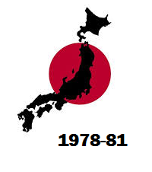

Slide 3
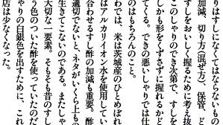

Slide 4
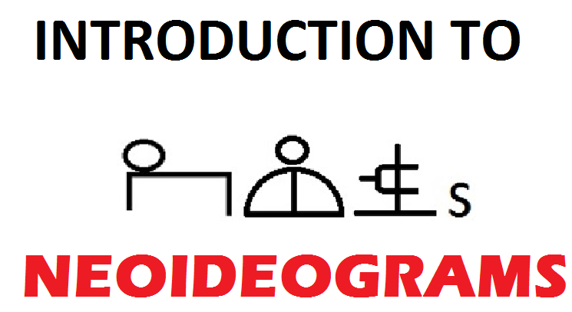

Slide 5
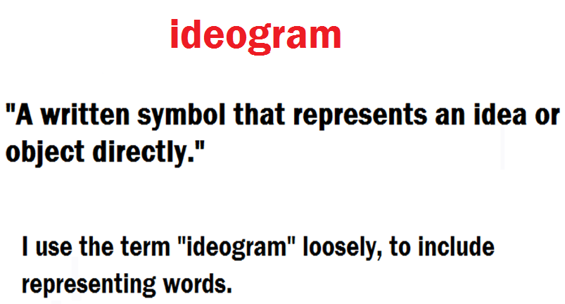

Slide 6

CHINESE CHARACTERS
FULL OF CHARACTER AND THEY WORK, BUT ALSO OVERLY-COMPLEX, ANTIQUATED , AND INEFFICIENT.
Notes:
PALEO-IDEOGRAMS

Slide 7
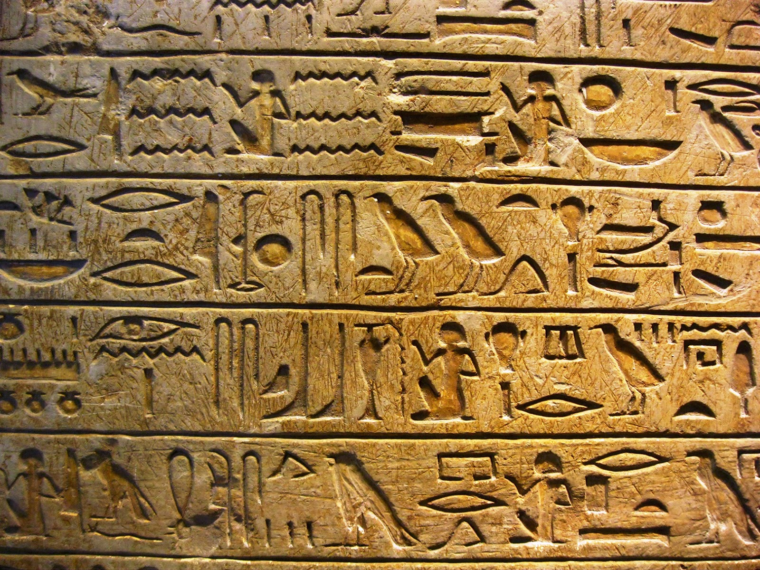
ANCIENT EGYPTIAN HIEROGLYPHICS
AWESOME, BUT NOT USABLE IN THE MODERN WORLD.
Notes:
PALEO-IDEOGRAMS

Slide 8
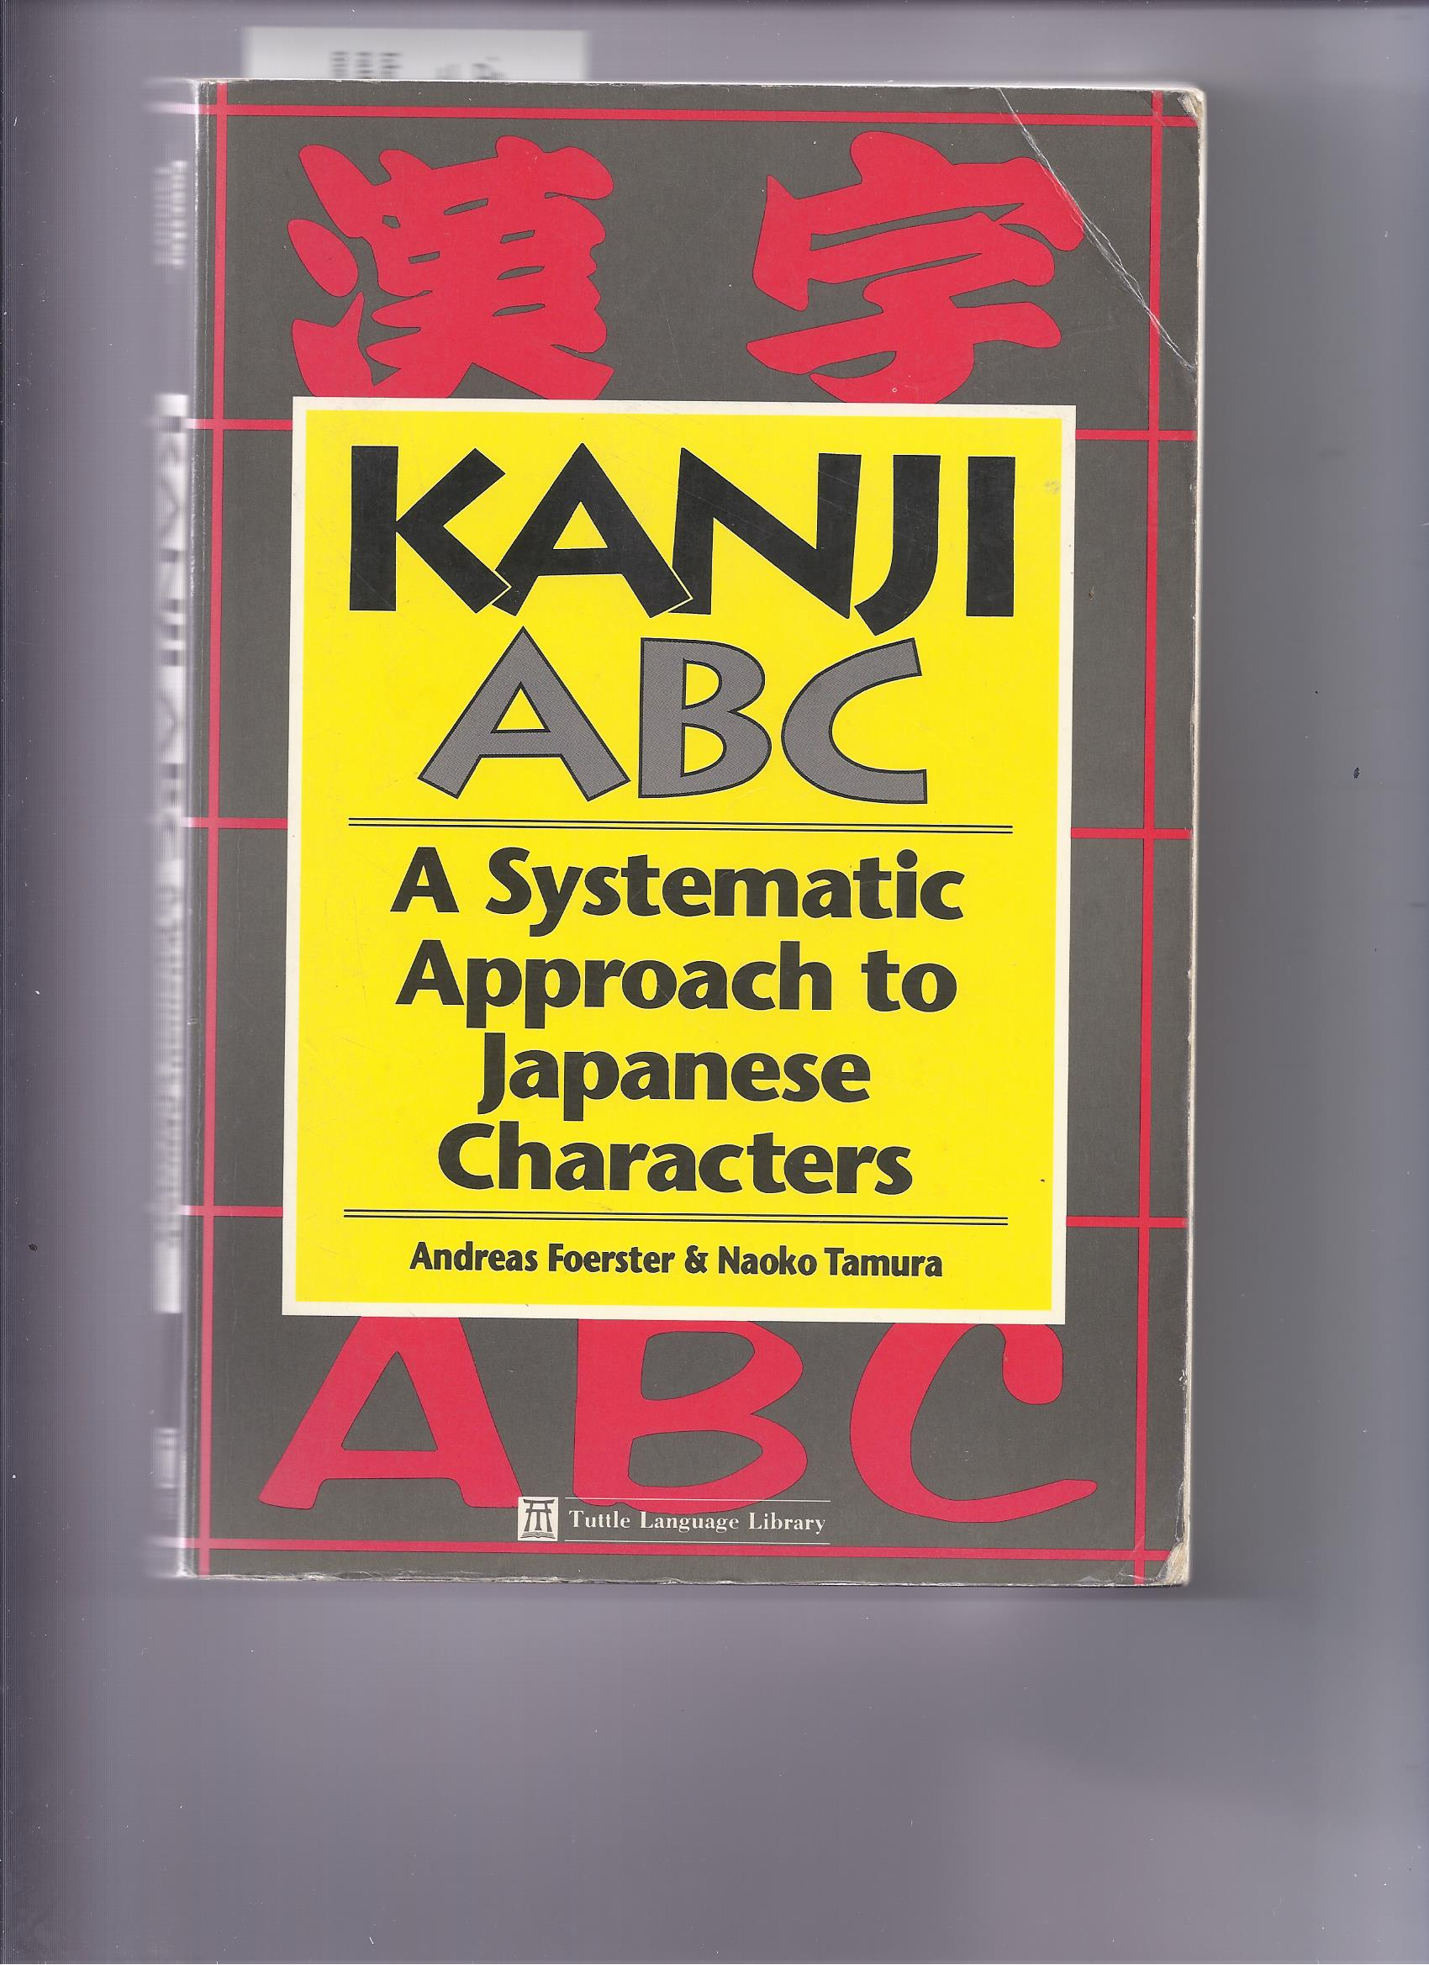
Notes:
About 5 years ago I was reviewing kanji (Chinese characters) in this book . . .

Slide 9
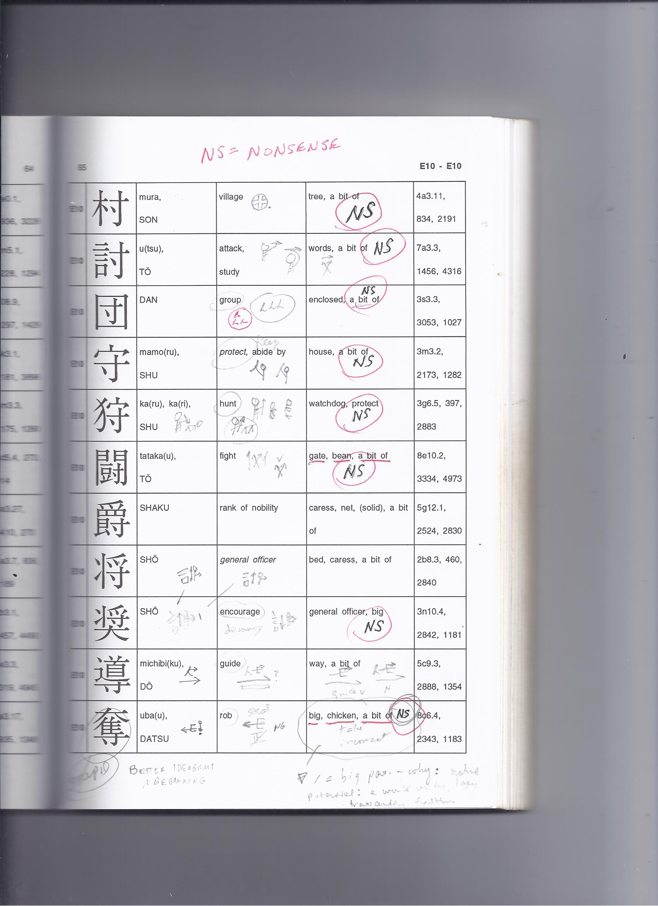
Notes:
I don’t know if you can see it, but the components of the one on the bottom are big, chicken, a bit of, and it means “rob”. Does that make any sense? I became disgusted at how many of them don’t make sense (yet was convinced of the power and value of ideograms . . . And so decided to make my own, for English!

Slide 10


Slide 11
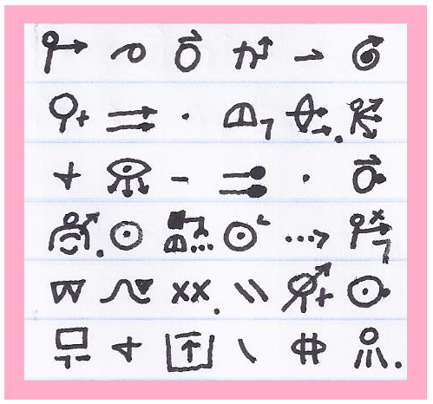
NEO-IDEOGRAMS: MODERN, EFFICIENT, MAKE SENSE
Transcription: Do what you can to create better ways of thinking clearly. Explore and observe the results of your effort. I guess I’ll continue using these strange things. They improve my mind and fill it with light.
Notes:
NEOIDEOGRAMS, OR “IDS”

Slide 12
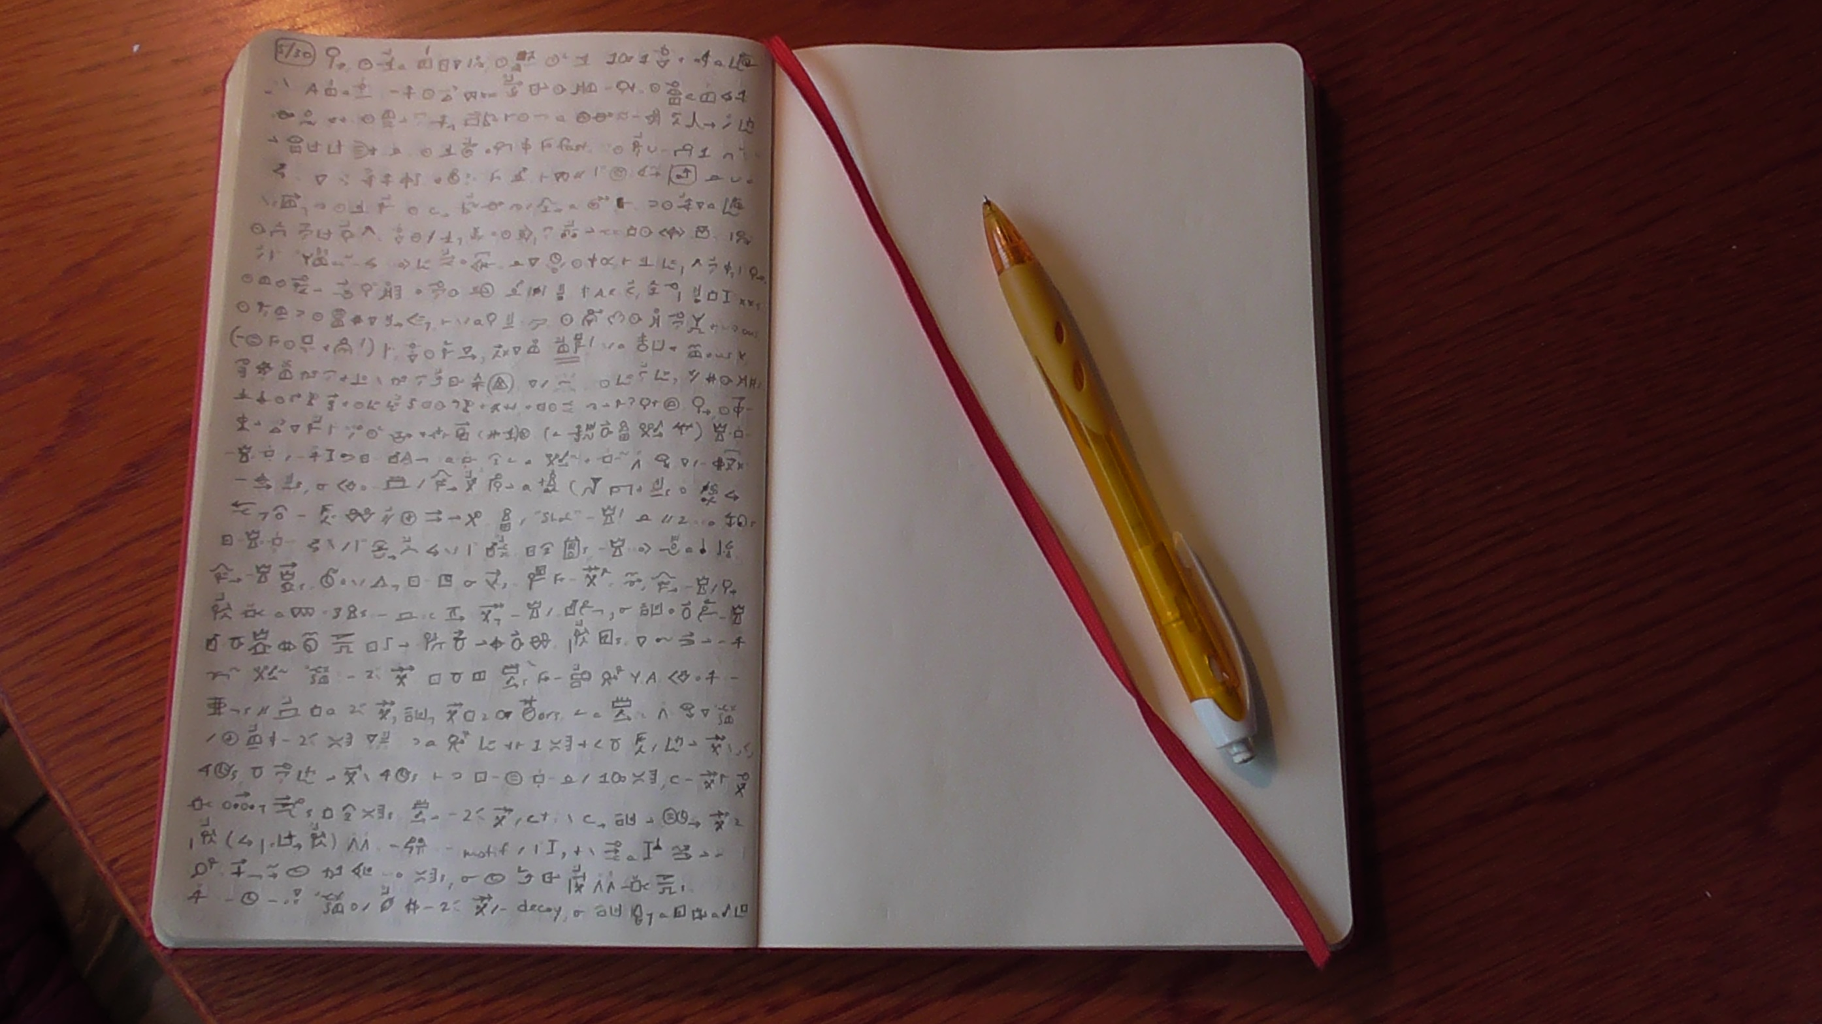
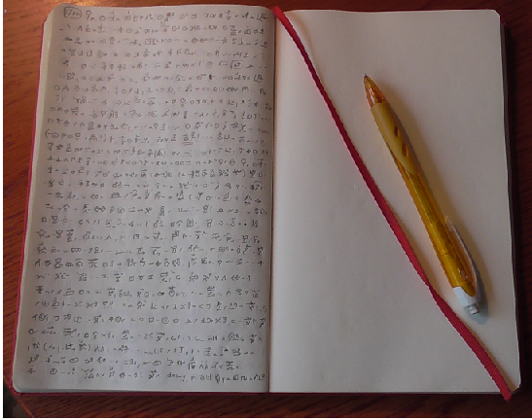

Slide 13
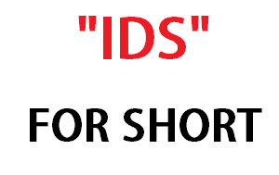

Slide 14
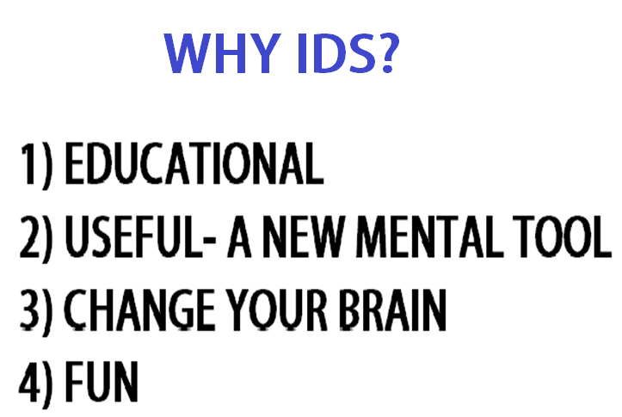

Slide 15
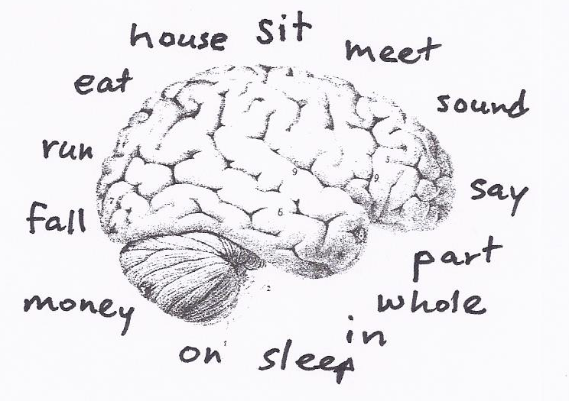
Notes:
This project has changed me psycologically; I have a different relationship to language. In addition to this. . .

Slide 16
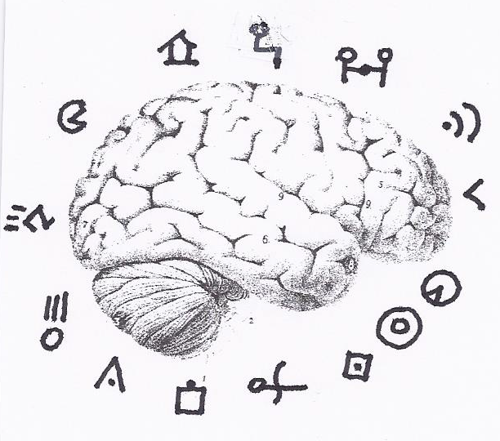
Notes:
Surely graphic images function differently in the brain from alphabetic writing. They interconnect differently—perhaps better, and are stickier—more memorable, which is why they are used in mnemonics.

Slide 17
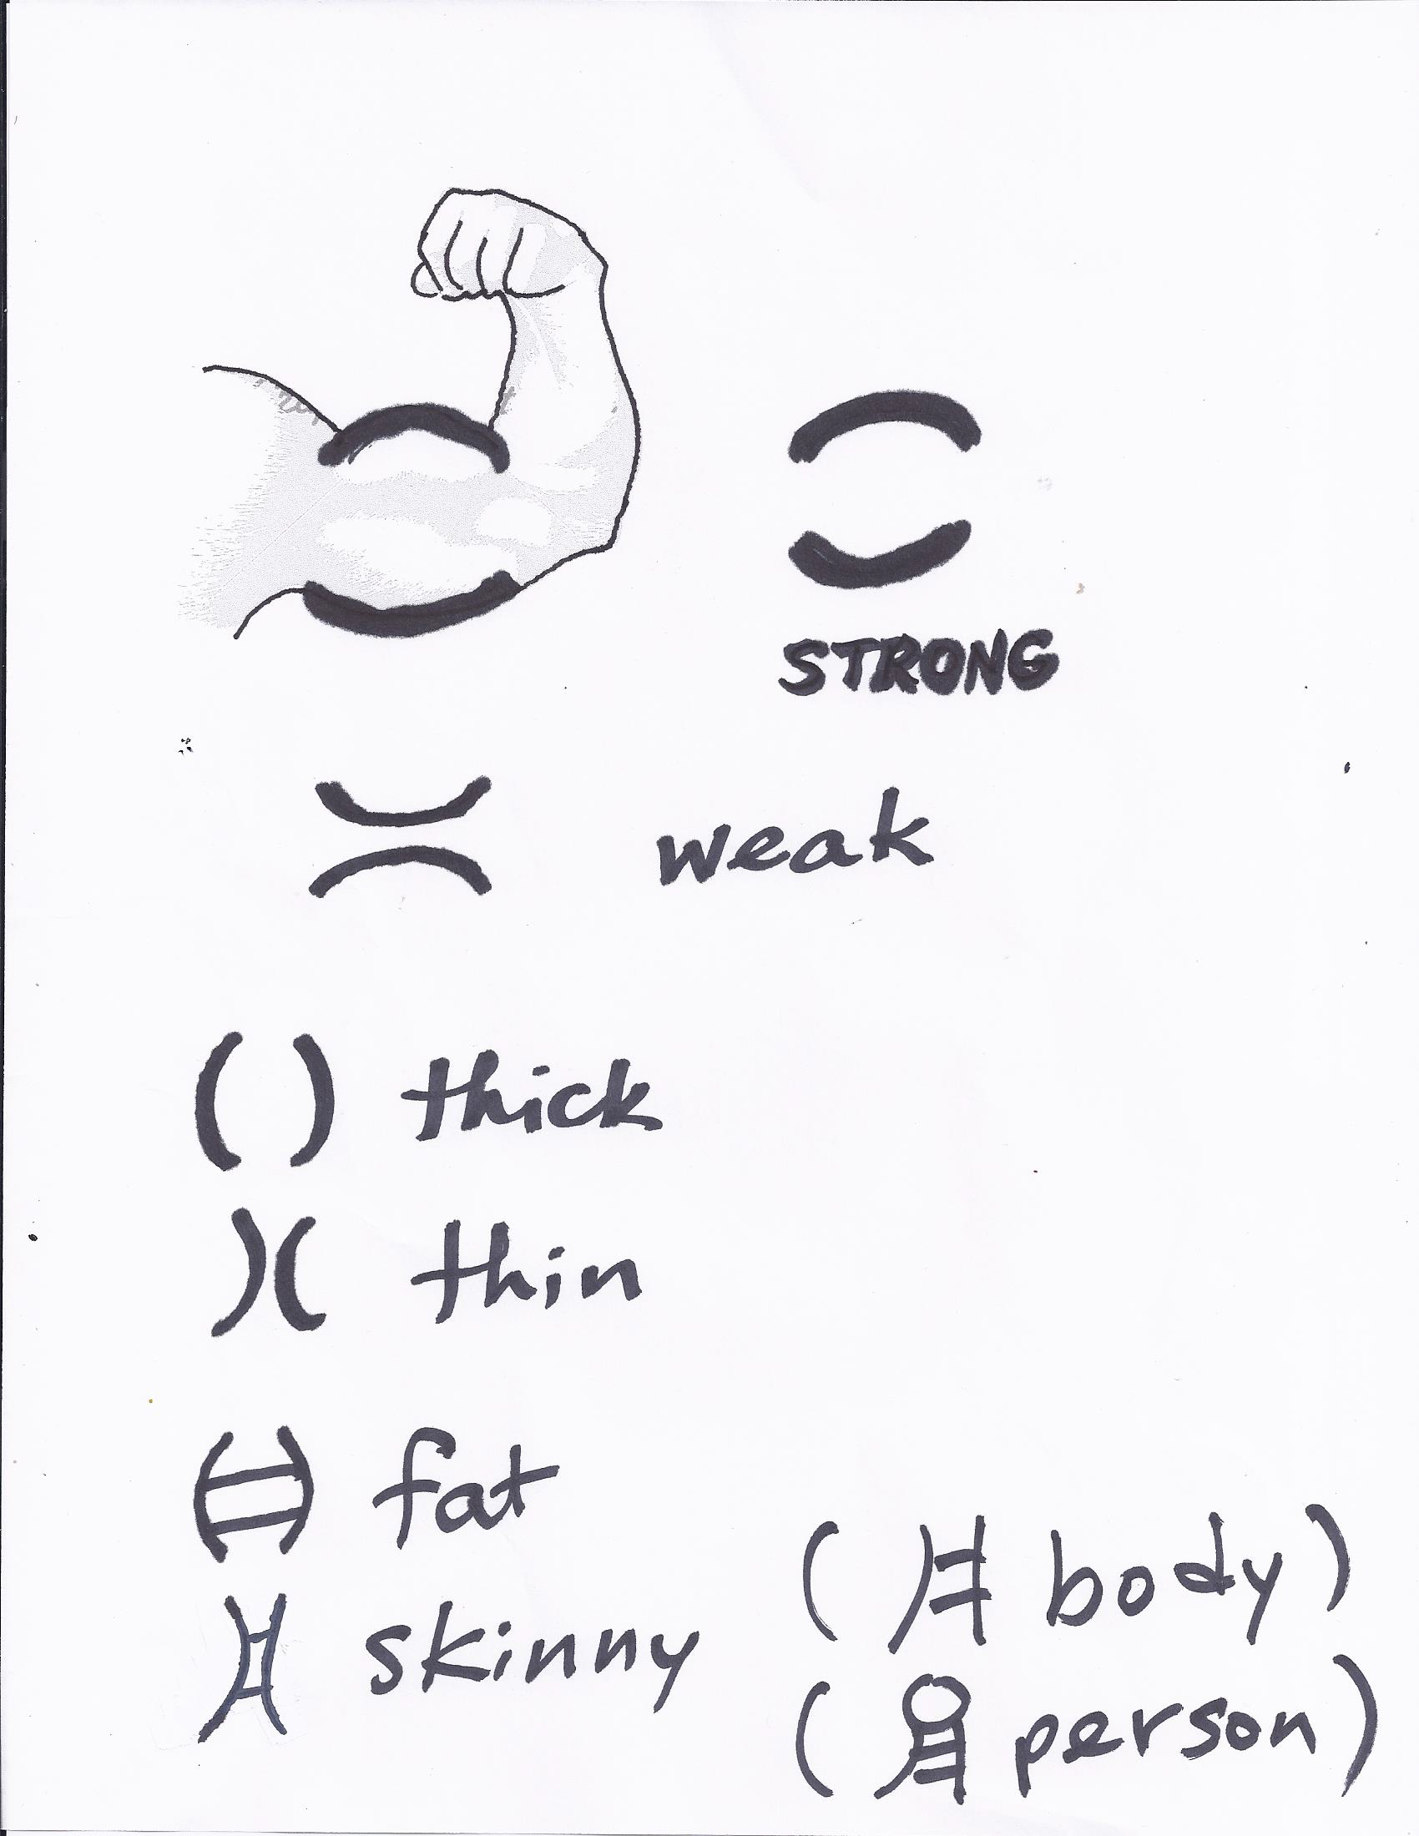
Notes:
AN EXAMPLE OF TAKING FROM REAL LIFE, PICTORIALNESS

Slide 18
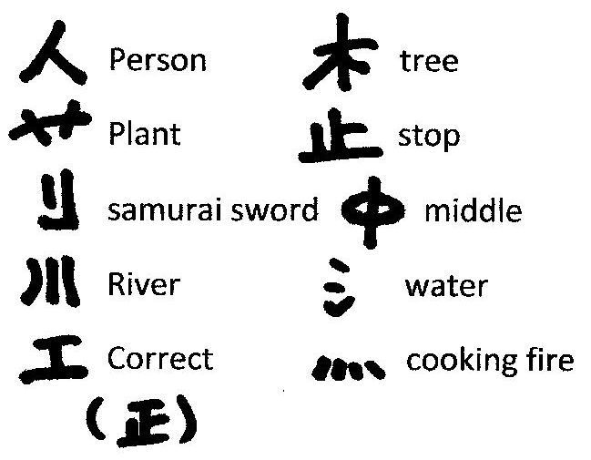
Notes:
FROM CHINESE CHARACTERS

Slide 19
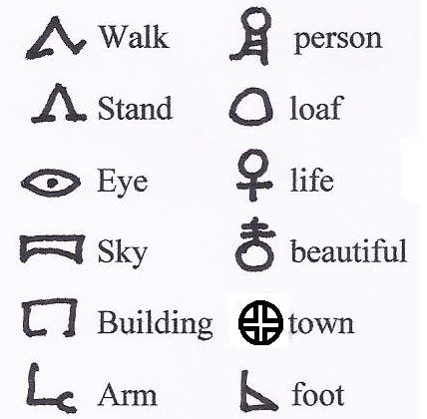
Notes:
I researched hieroglyphics and selected a few that I liked.

Slide 20
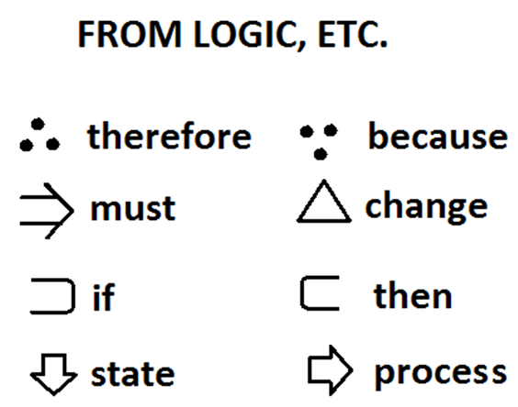

Slide 21
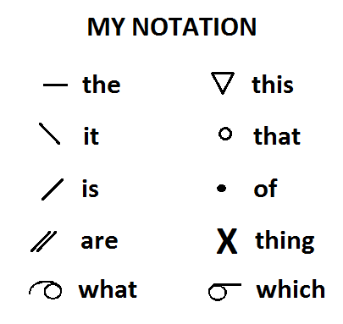

Slide 22
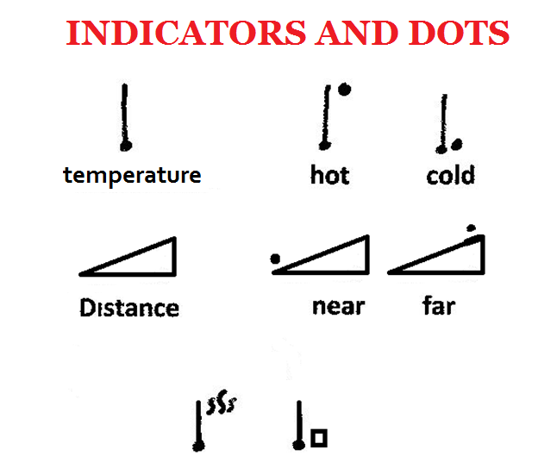

Slide 23
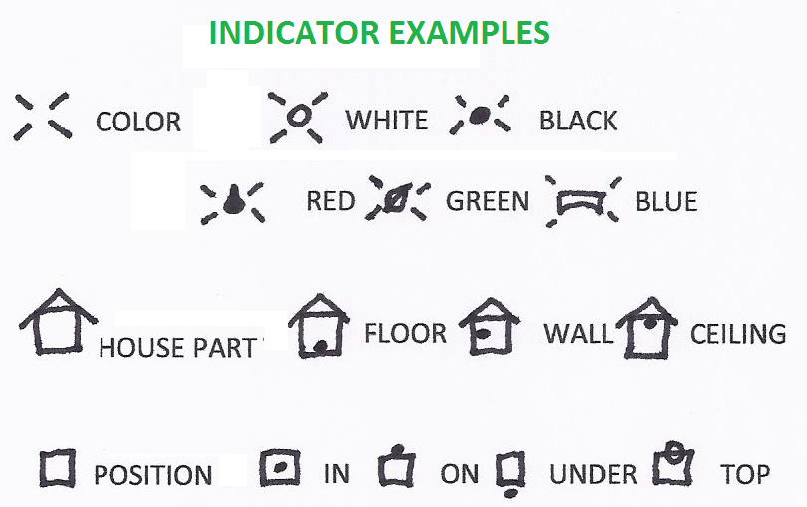

Slide 24
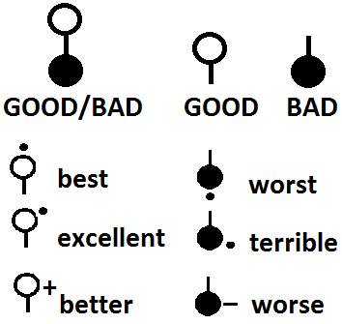

Slide 25
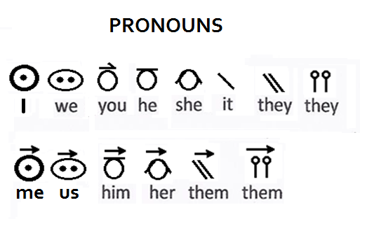
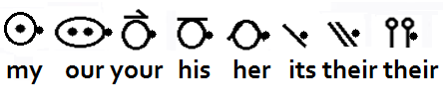

Slide 26
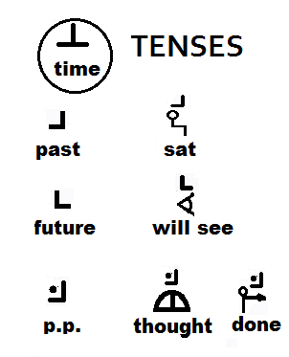

Slide 27
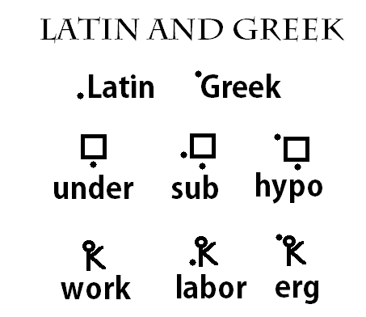

Slide 28
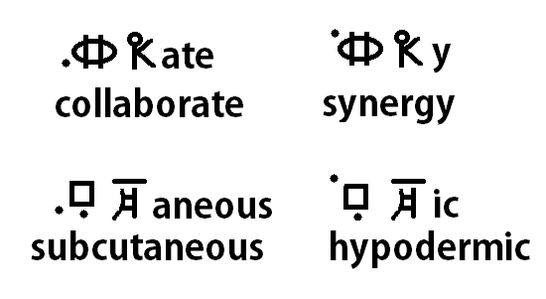

Slide 29
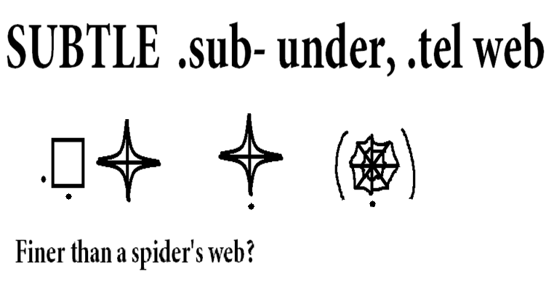
Notes:
One advantage of etymids is that they force one to think about the meanings of the parts of Latin and Greek derived words.
“Subtle” (under +web) didn’t make much sense to me until I got the idea that it might mean something like “finer than a spider’s web.”

Slide 30
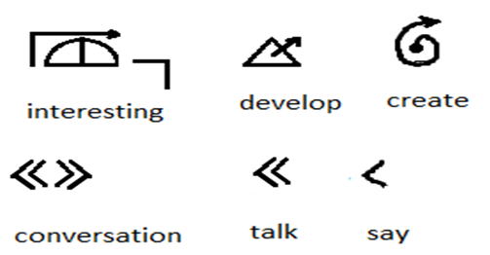


Notes:
To show that I don’t always use word roots, but sometimes represent the words more directly.

Slide 31
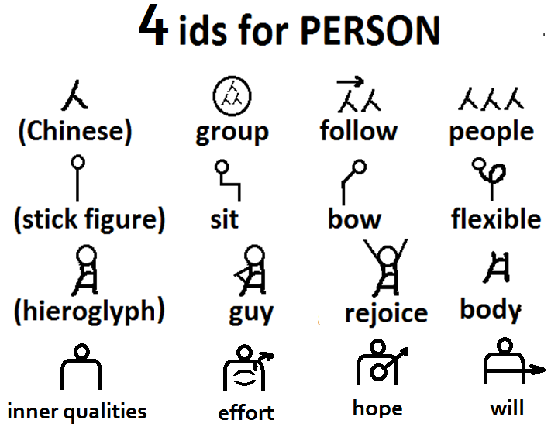

Slide 32
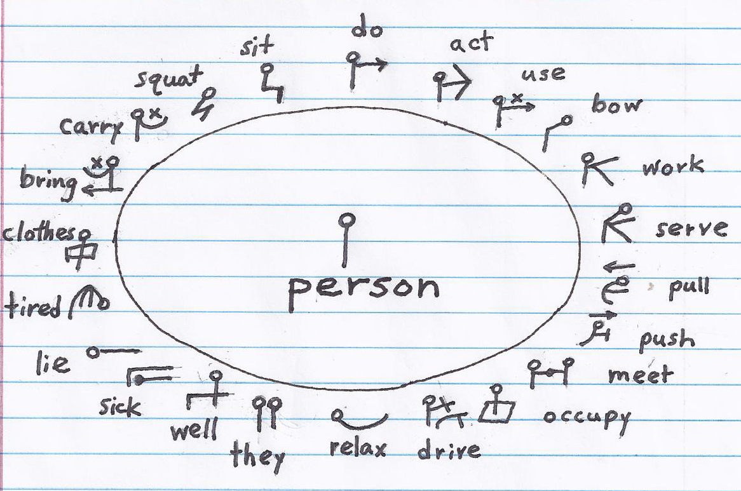

Slide 33
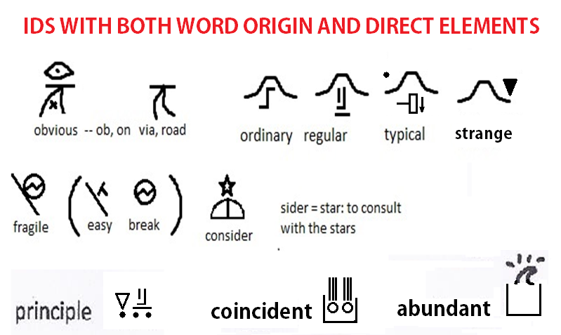

Slide 34
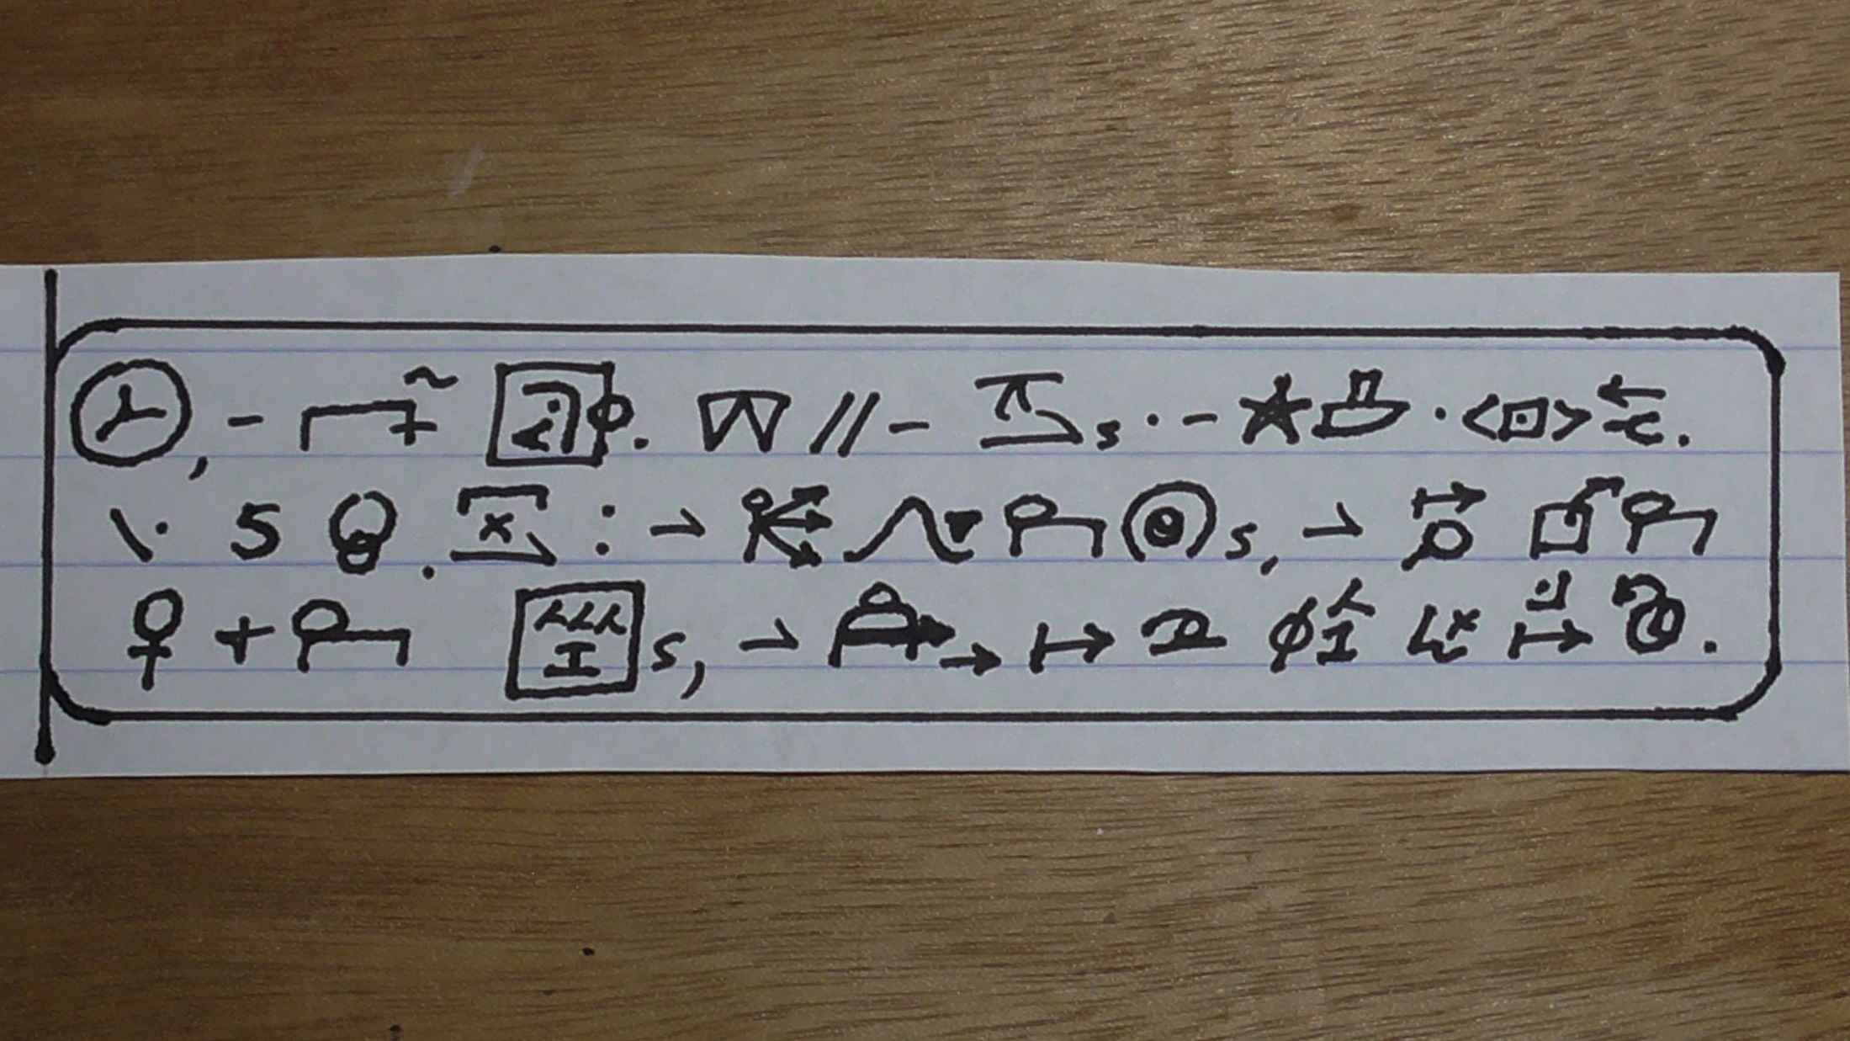
Space, the final frontier. These are the voyages of the starship Enterprise. Its five-year mission: to explore strange new worlds, to seek out new life and new civilizations, to boldly go where no one has one before.

Slide 35
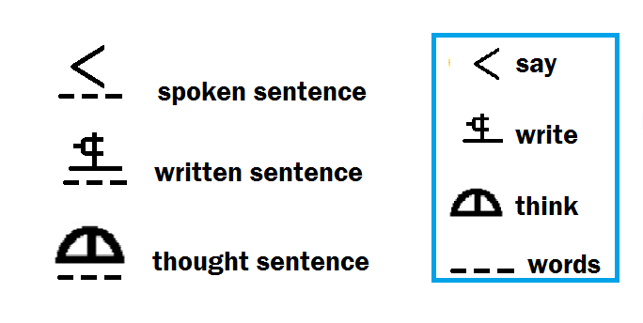

Slide 36
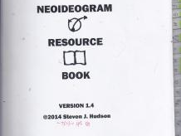
I have a “dictionary” available that covers about 6,000 English words.
NEOIDEOGRAMS.WORDPRESS.COM

